Slide 1

Phishing Awareness: Protecting Our Digital Frontline
Phishing remains the primary cause of cyber incidents in the UK. Human error contributes to 85% of breaches. Every employee is a vital layer in our digital defence.
By Momal Naz
CA/JU1/15380

Slide 2

What Exactly Is Phishing?
Fraudulent Attempts
Scammers try to obtain sensitive data.
Various Channels
Via email, SMS (smishing), voice calls (vishing).
Impersonation
They pose as trusted banks or colleagues.
Their Goal
Steal credentials, finances, or deploy malware.

Slide 3
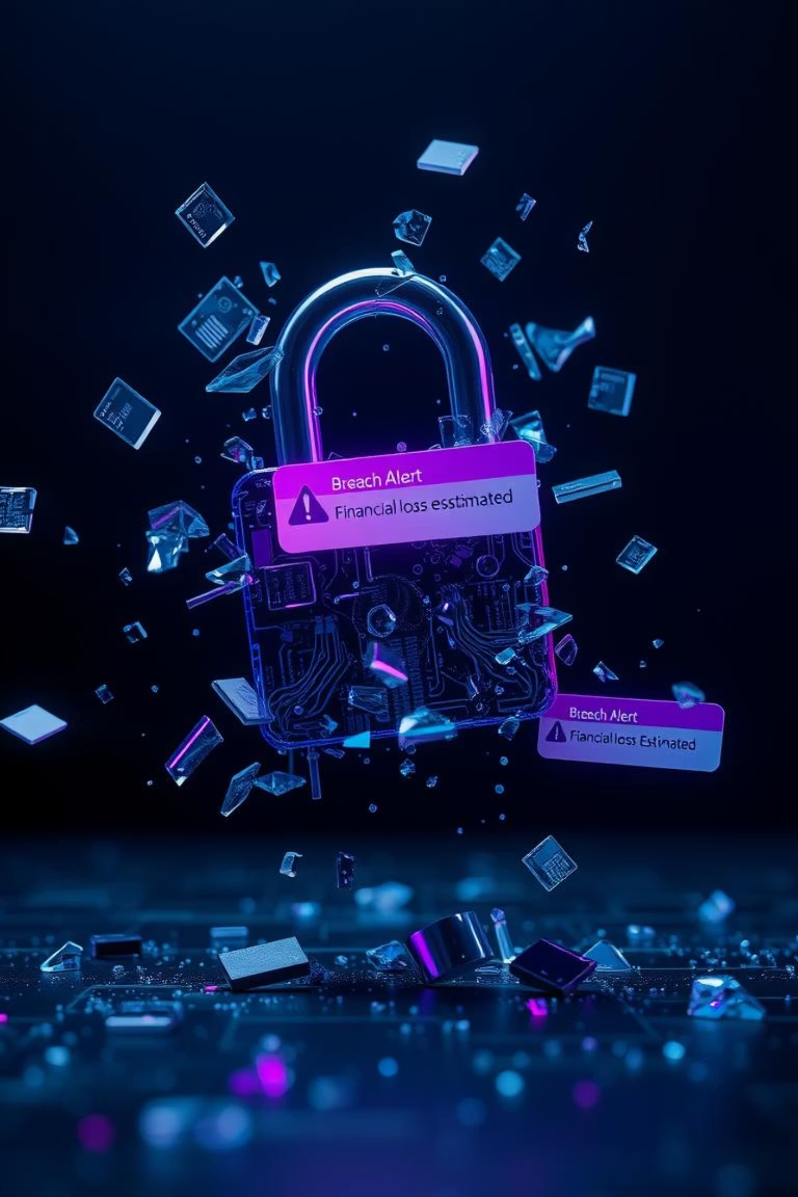
Why Is Phishing Such a Major Threat?
£25.7M
£3.4M
All
UK Losses
Breach Cost
Industries Targeted
Businesses lost to fraud in H1 2023.
Average data breach cost in the UK (2023).
From SMEs to large corporations face risks.

Slide 4
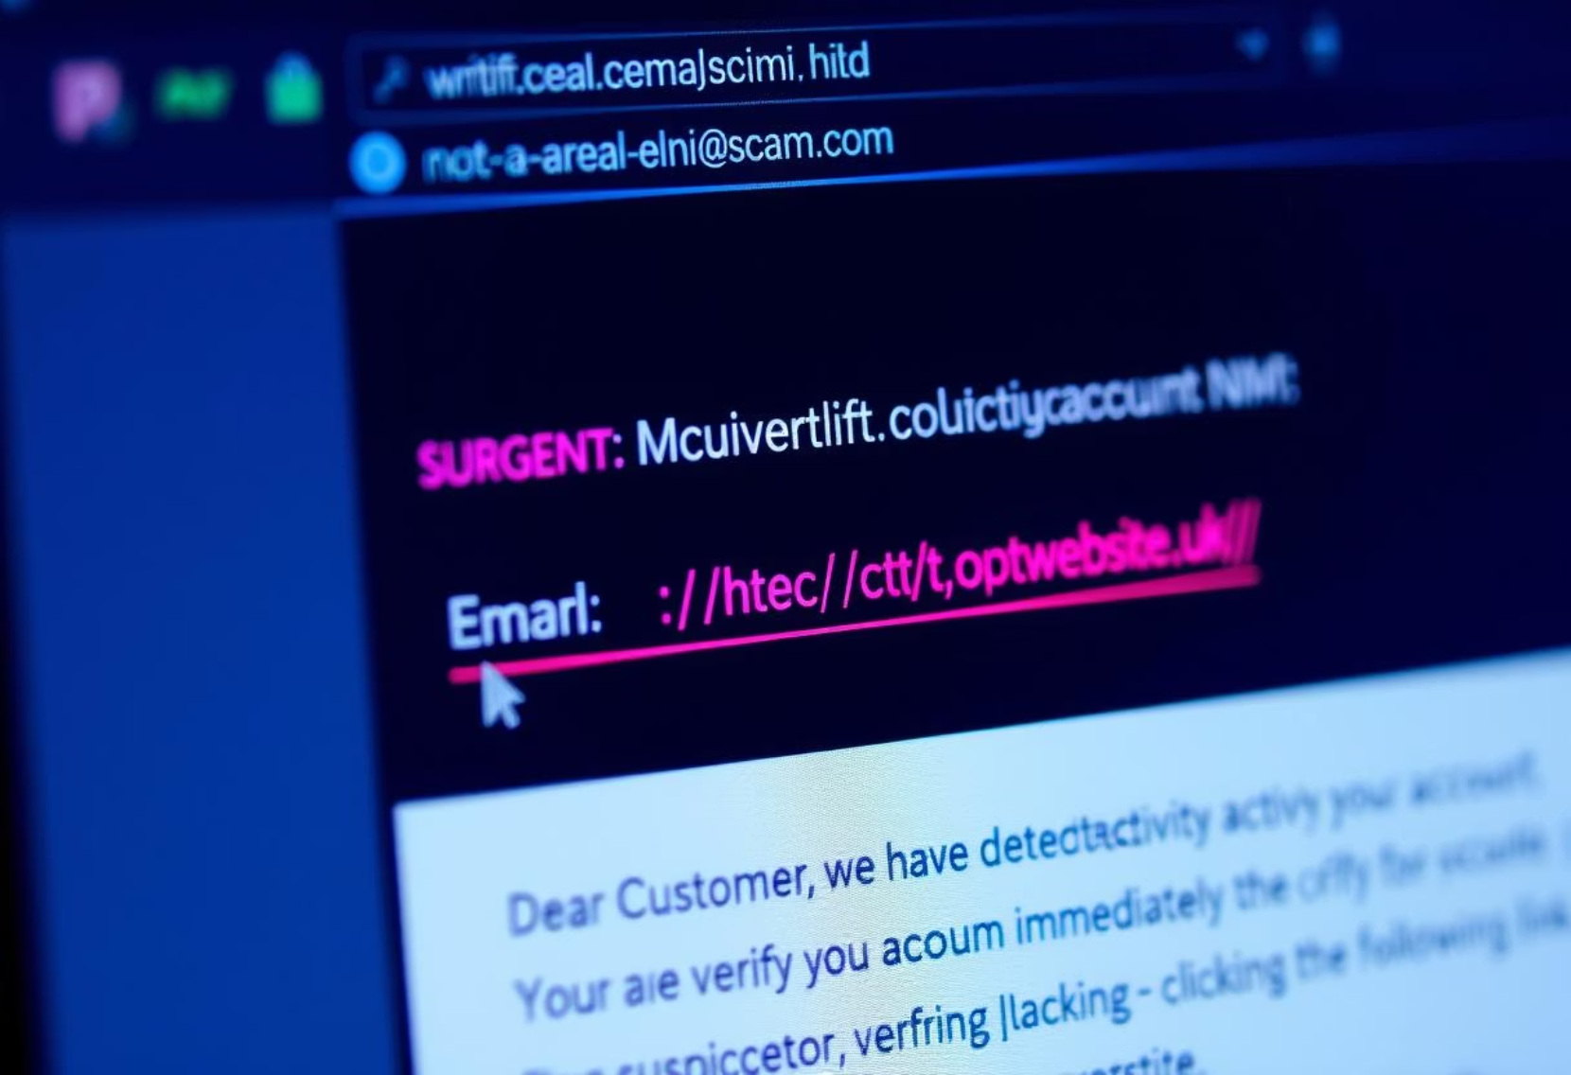
How to Spot a Phish: Technical Red Flags
Sender Address
Look for mismatched domains (e.g., paypal@secureserv.co.uk).
Suspicious Links
Hover before clicking; check the URL (e.g., goo.gl/malicious).
Generic Salutations
Beware of "Dear Customer" instead of your name.
Unexpected Attachments
Watch for .exe, .zip, or unusual document types.

Slide 5
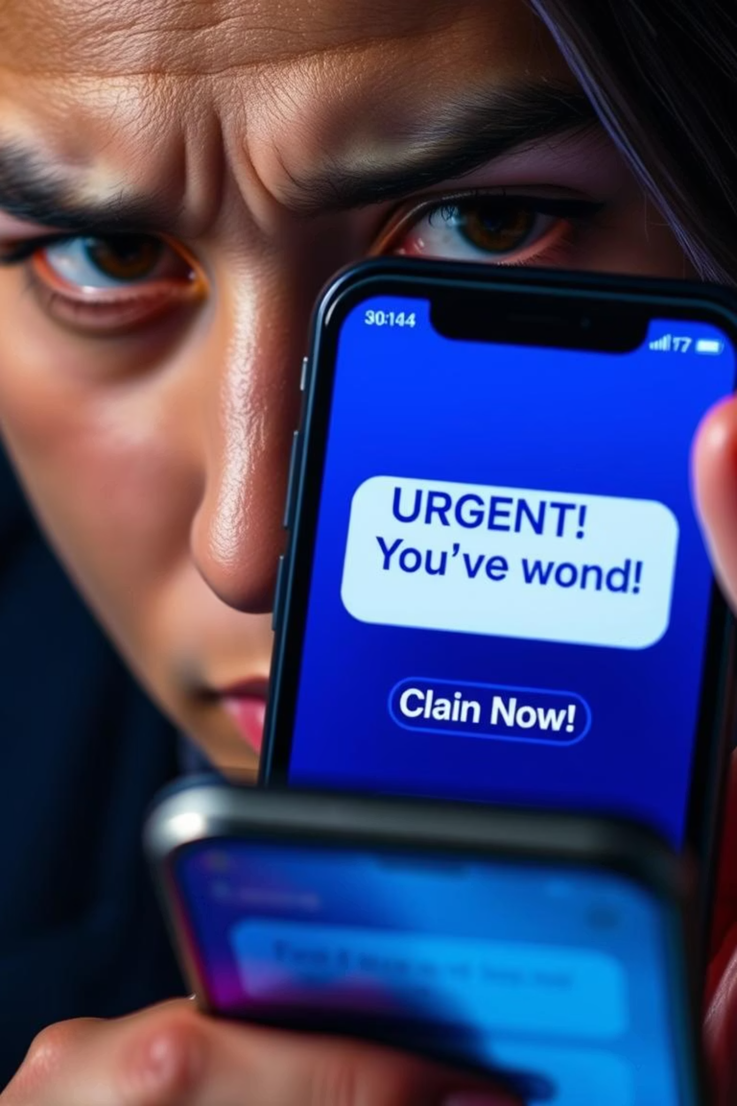




How to Spot a Phish: Content & Context Red Flags
Urgency/Threats
"Account suspended! Act now!" messages.
Unusual Requests
Asks for gift cards, bank details, passwords.
Grammar/Spelling
Frequent mistakes in the text.
"Too Good To Be True"
Unexpected lottery wins, large refunds.

Slide 6
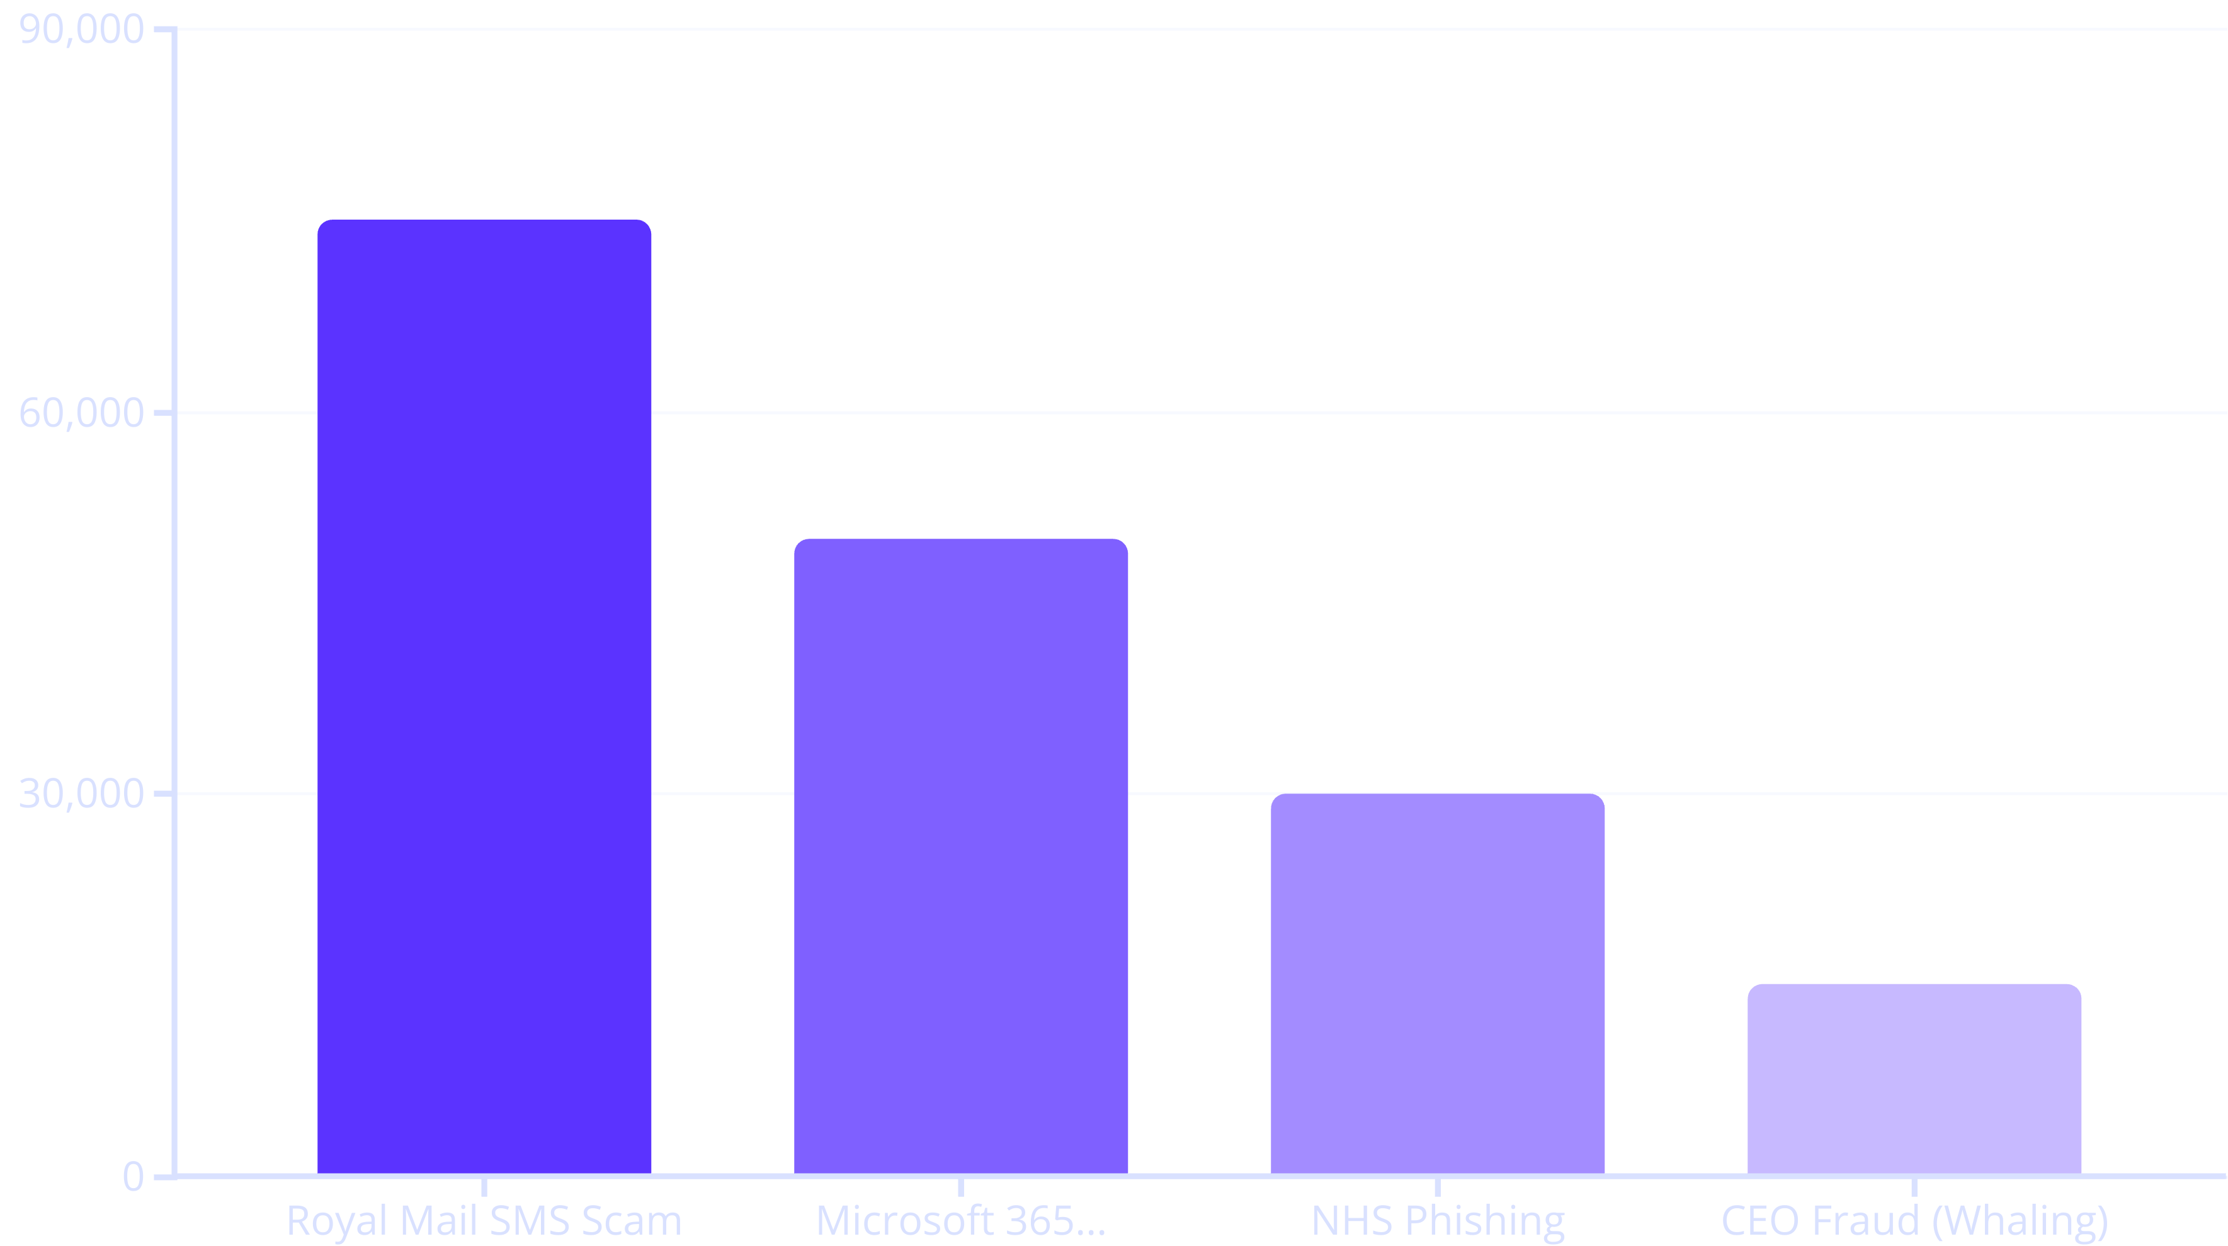
Real-World Phishing Examples
These examples highlight the varied methods used by attackers. From fake delivery fees to impersonating executives, vigilance is crucial.

Slide 7
What to Do If You Suspect a Phish
DO NOT Interact
VERIFY Sender
Avoid clicking links or opening attachments.
Confirm legitimacy via official channels.
DO NOT Reply
REPORT & DELETE
Never provide information to suspicious senders.
Inform IT Security, then delete the message.

Slide 8



Conclusion: Your Vigilance is Key
Phishing attacks are evolving, but they are preventable. Every report strengthens our collective defence. Be suspicious, be vigilant, be safe online. You are our first and best line of defence.

